Slide 1

Facilities Smart Grid Information Model Demonstration
By:
Abhinav Verma
Consultant/ Analyst
ESTA International

Slide 2
Overview

Slide 3
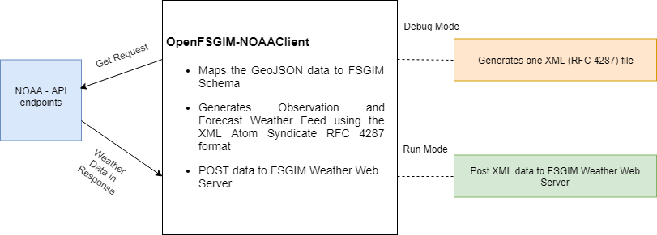
NOAA Client - Overview

Slide 4
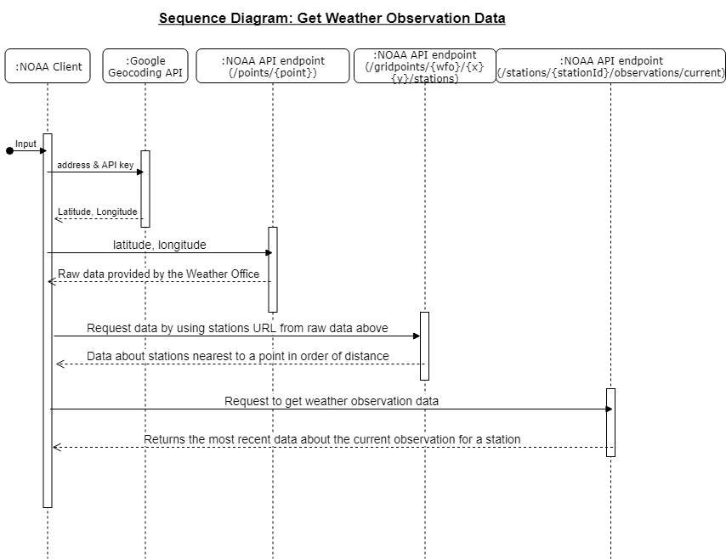
NOAA Client

Slide 5
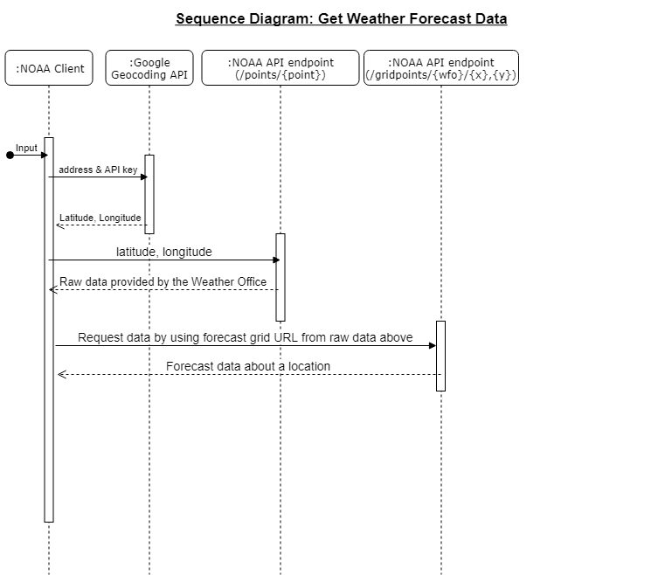
NOAA Client

Slide 6
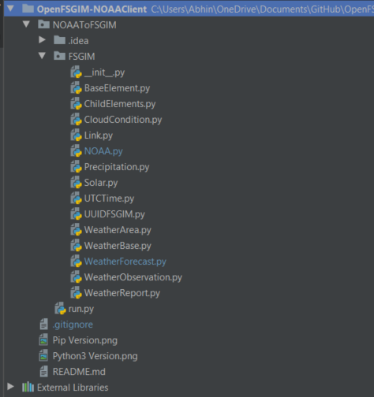
NOAA Client – Application Structure

Slide 7
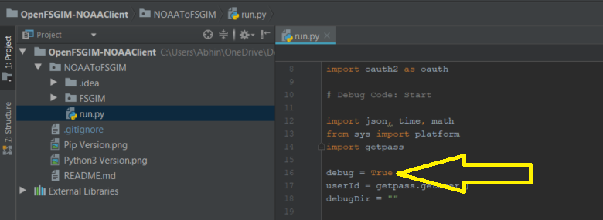
NOAA Client – Debug Mode

Slide 8
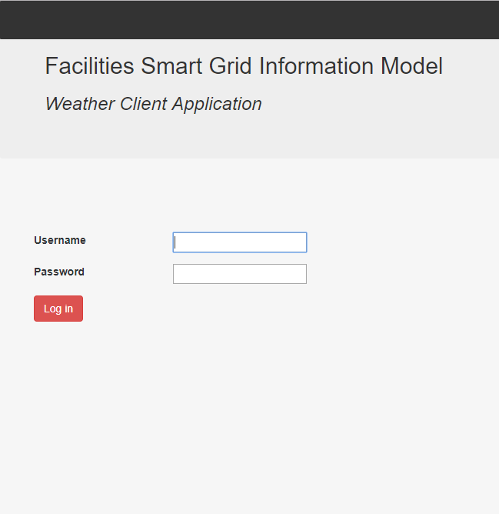
Simple Client – Overview
Python 3.5.0
Django 2.0.1
Pycharm Python IDE 2017.3.1
Bootstrap 3.3.7

Slide 9
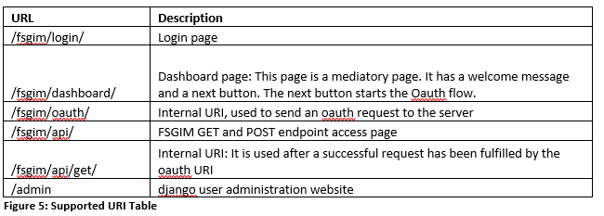
Simple Client – Supported URI

Slide 10
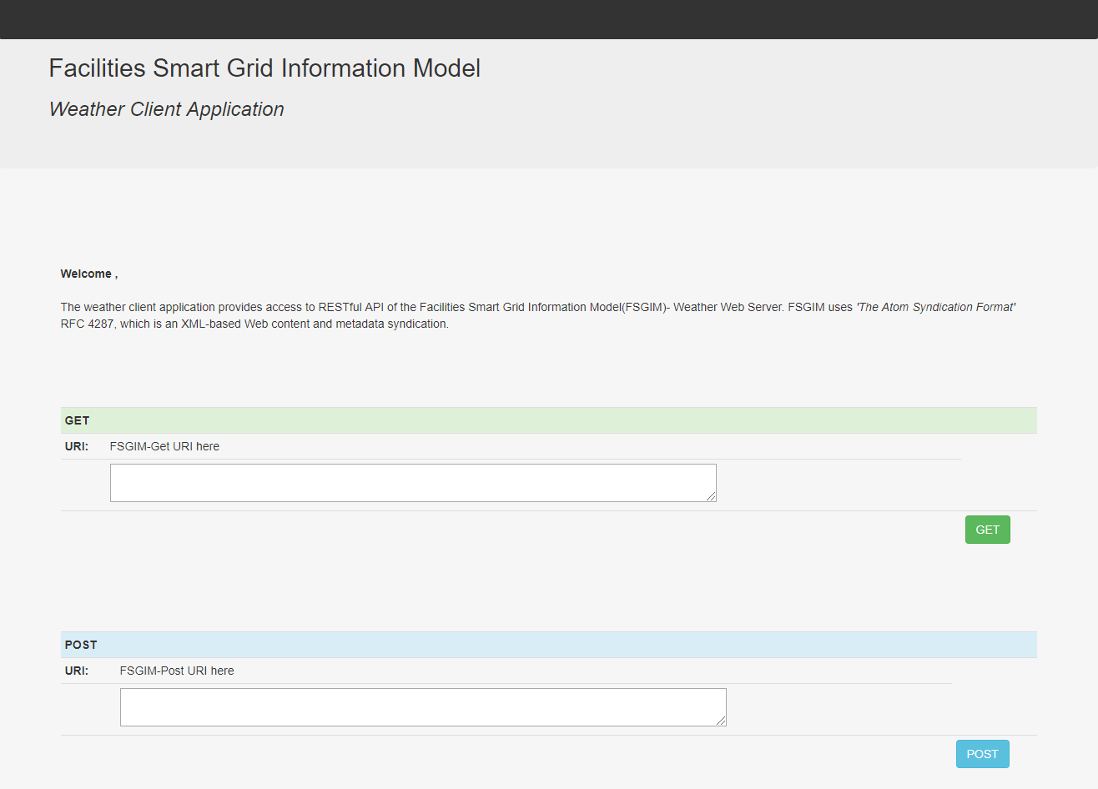
Simple Client – API Access Page

Slide 11
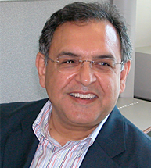

Contact at ESTA
Nader Farah
Project Manager and Smart Grid Expert
Mobile: +1 703 200 7381
nader.farah@ESTAInternational.com
Team
Allen Jones
FSGIM Model Subject Matter Expert
Donald F. Coffin
OpenESPI/ Green Button Subject Matter Expert
Abhinav Verma
Software Developer (Java, C#, Python)
ESTA International
2214 Rock Hill Road, Suite 180
Herndon, Virginia VA 20170, USA
Tel: +1 703 579 1944
Fax: +1 703 579 1954
info@ESTAinternational.com

